Slide 1
Semen Analysis and male fertility disorders
Dr. Anura Dissanayake
Dept. of Obstetrics and Gynaecology

Slide 2
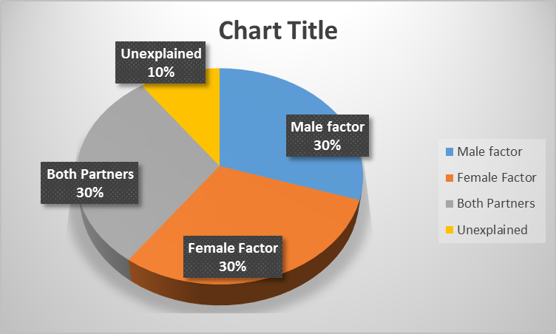
Male infertility
Inability of man to impregnate a fertile woman
It is solely responsible for 30% of couple’s infertility
May extend to 40-50% as a contributory factor

Slide 3
Causes and evaluation
Causes
Low sperm production
Low semen quality
Transportation failures (erectile / ejaculatory)
Evaluation
History taking
Physical examination
Laboratory investigations – Semen analysis and other tests
Advanced fertility evaluations

Slide 4
What is semen?
A mixture consisting of sperm, seminal plasma and other cells.
Seminal Plasma
    Epididymal fluid
    Seminal vesicle fluid
    Prostatic fluid
Cells
    Immature germ cells
    Epithelial cells
    Leucocytes
    Bacteria / RBC (in pathological conditions)

Slide 5
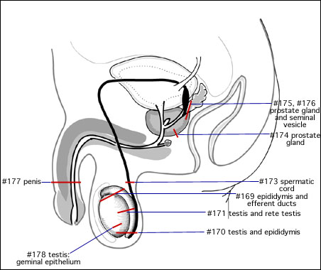
Contribution
65 – 75 %
25 – 30 %
1 %
2 – 5 %

Slide 6
Composition
Seminal vesicle secretions (Acidic)
  Proteins (seminogelin)
  Enzymes (Protein kinase)
  Free amino acids
  Sugars (Fructose, Inositol, Sorbitol)
  Phosphorylcholine (lipids)
  Nitrogen bases (Spermine, Spermidine)
  Prostaglandins
  Ascorbic acid, Uric acid, Lactic acid, Pyruvic acid

Slide 7
  Prostate secretions (Alkaline)
    Acid phosphatase
    Citric acid
    Prostate specific antigen (decoagulant)
    Proteolytic enzymes (Fibrinolysin)
    Zinc

Slide 8
Bulbourethral gland
  Mucoproteins
  Sialic acid
  -Neutralize residues of urine
Epididymis
  Neutral Alpha Glucosidase (NAG)
  L-Carnitine
  Glycerophosphocholine

Slide 9
Role of seminal plasma
Protection of sperm from
  Oxidative stress
  Vaginal acidity
  Bacteria, Immune cells
Provide nutrients
Medium to swim
Regulate biochemical processes (eg, hyperactivation, capacitation, acrosome reaction)

Slide 10
Semen analysis
Evaluate the number and quality of sperm, and seminal plasma manually or using computer assisted semen analyses software (CASA)
Aims of SA
To evaluate male fertility potential
  - Before marriage
  - Delay in conception in married couples
  - Donor samples
To confirm the success of vasectomy
To cryopreserve sperm prior to surgery or chemotherapy

Slide 11
Sample collection
Abstain from ejaculation between 2-5 days
Wash hand and penis using soap and water
Dry thoroughly using clean tissue papers
Collect in to wide mouth sterile container without spillage
Handover within 30 minutes to the lab

Slide 12
Collection methods
Masturbation
Coitus using non-spermicidal condoms
Special devices for erectile dysfunctions
  Vacuum devices
  Vibrator
  Electroejaculator

Slide 13
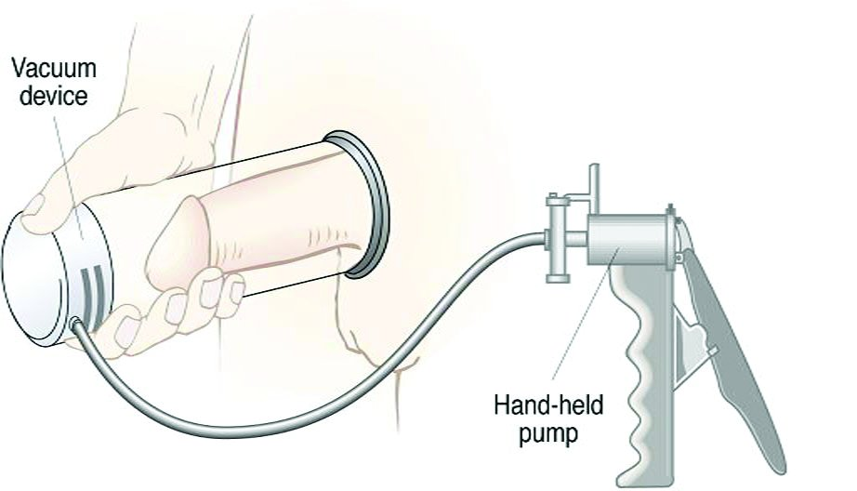
Special devices

Slide 14


Vibratory stimulation and Electroejaculation

Slide 15
Don’t
  allow to spillage – sperm rich first portion may lost
  use lubricants - spermicides
  use ordinary condoms in the market - spermicides
  collect by coitus interruptus - vaginal acidity/bacteria
  use ice for transporting the sample – sperm death

Slide 16
Methods of assessment of semen parameters
Volume Graduated conical tube
Liquefaction time
pH pH meter / pH paper
Viscosity Passing through pipette
Colour
Concentration Makler counter
Motility
Viability Eosin/Nigrosin
Morphology Papanicolaou
Immature germ cells
Leucocytes Peroxidase stain

Slide 17
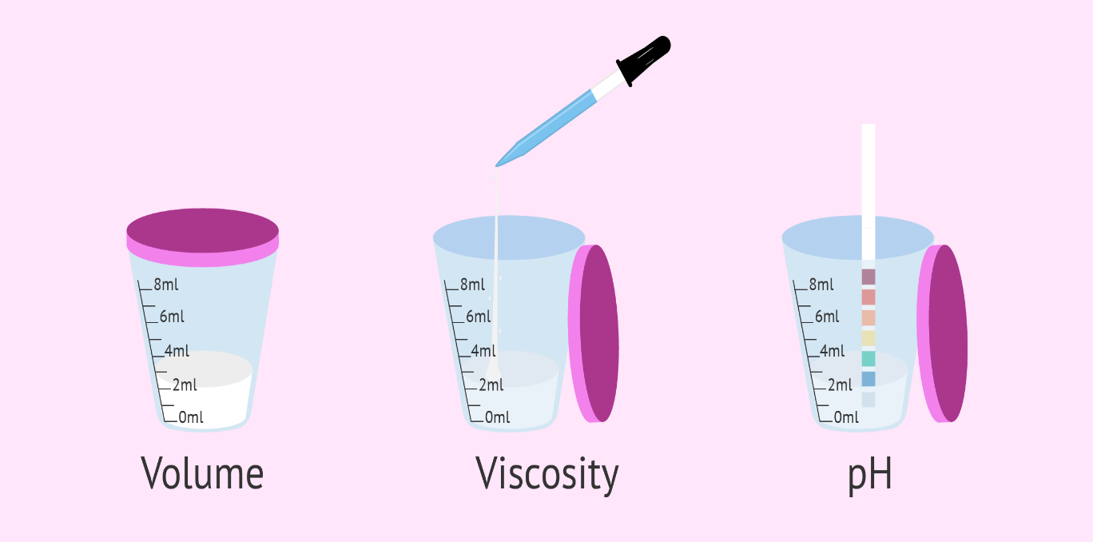
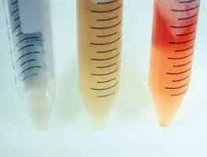
Color
Volume / Viscosity / pH
Normal
Abormal

Slide 18

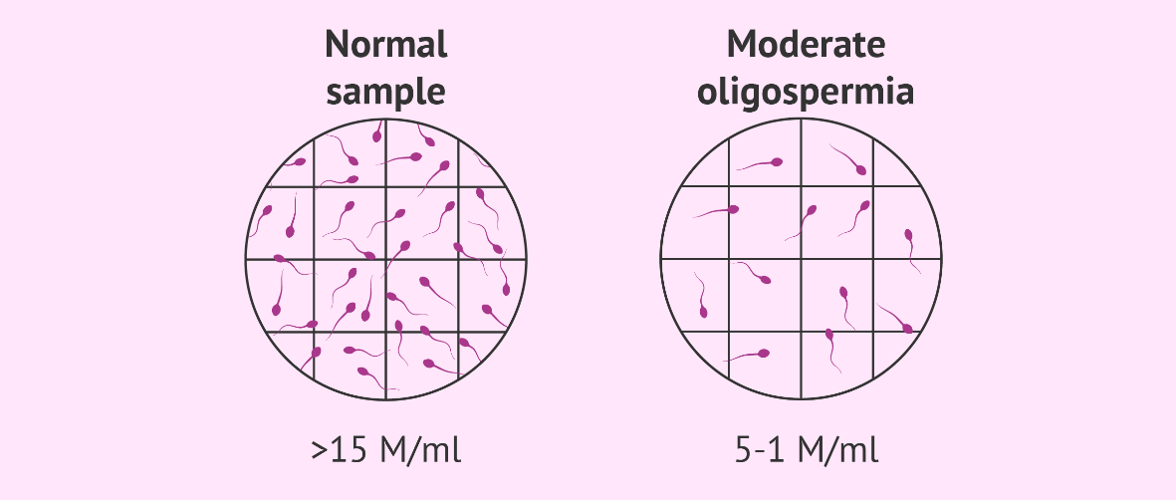
Count
Motiility
Grade ‘A’
  >25 um/s
Grade ‘B’
  5-24 um/s
Grade ‘C’
  <5um/s
Grade ‘D’
  Immotile

Slide 19
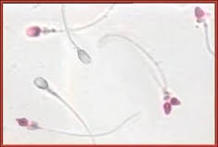
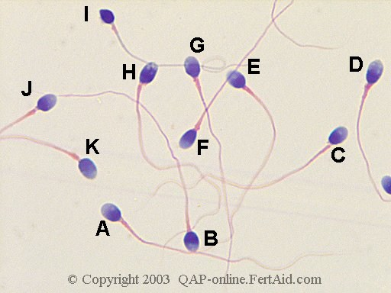
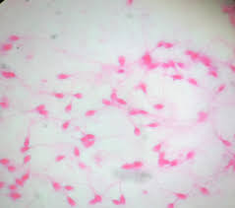
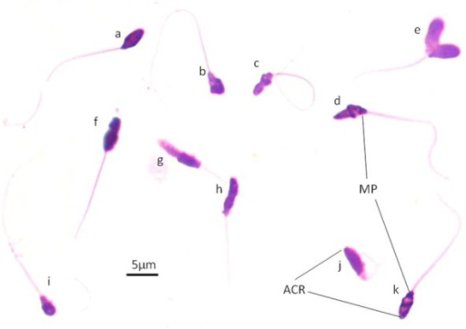
Viability
Morphology

Slide 20
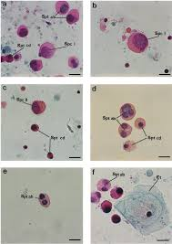
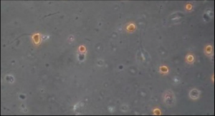
Other cells (Round cells)
Immature germ cells
Leucocytes

Slide 21
Normal ranges (WHO 2010)
Macroscopic parameters
(5th Centile)
Volume >1.5 mL
Liquefaction time <60 min.
pH >7.2
Viscosity low viscous
Colour Whitish gray

Slide 22
Microscopic parameters
(5th Centile)
Concentration >15 mn/mL
Total count >39 mn/mL
Progressive motility >32 %
Viability >58 %
Morphology >4 %
Round cells <1 mn/mL
Agglutination Nil

Slide 23
Nomenclature
  Normozoospermia – normal samples
  Aspermia – no ejaculate
  Oligozoospermia – low count
  Asthenozoospermia – low motility
  Teratozoospermia – abnormal morphology
  Azoospermia – no sperm
  Haemospermia – RBC in ejaculate
  Pyospermia – WBC in ejaculate
  Hypospermia – low volume
  Necrozoospermia – no live sperm

Slide 24
Interpretations
 | Testes | Epidid. | Prostate | SVs | Vasa
Volume |  |  | + | ++ | ++
pH |  |  | ++ | ++ | +
Visco |  |  | ++ | +
Count | ++ | + |  |  | +
Motility | + | ++ | + | +
Viability | + | ++ | ++ | ++
Morpho | ++ | +

Slide 25
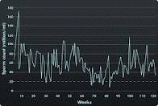
Abnormal semen samples
Repeat within two weeks
Repeat after three months
Refer to specialized tests

Slide 26
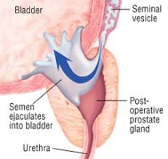
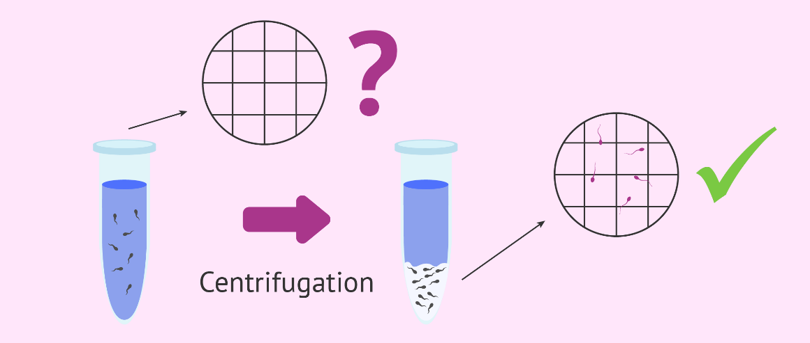
Confirmatory tests for azoospermia
Observe sperm in centrifuged samples
Examine post ejaculatory urine for retrograde ejaculation (If volume is < 0.5 ml)
Assess fructose level to exclude obstruction at the vasa level
Testes biopsy

Slide 27
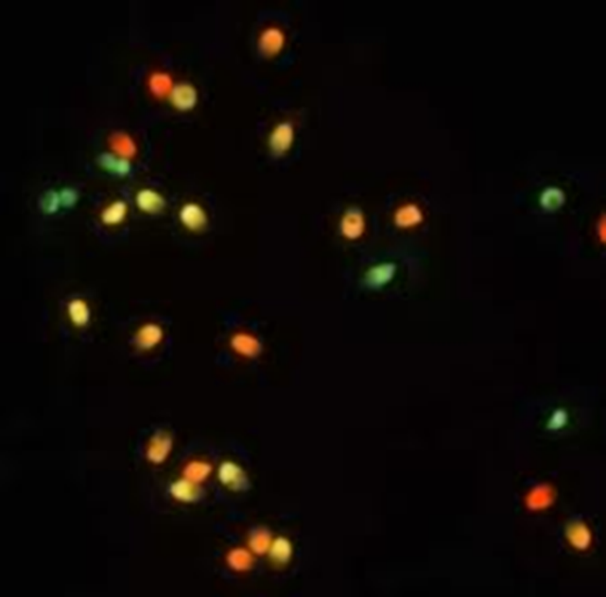
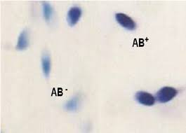
Special tests for sperm & seminal plasma
a) For Sperm
DNA damage
(acridine orange stain)
Chromosome condensation
(aniline blue stain)

Slide 28
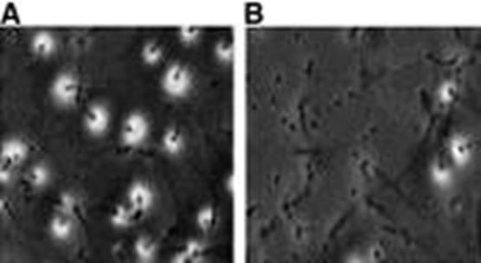
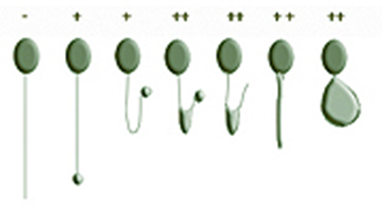
Hypo-osmotic swelling test (HOST)
Evaluates membrane integrity
Acrosome reaction (AR)

Slide 29
b) For seminal plasma
Biochemical Assays
Fructose (SV)
Zinc (Prostate)
NAG (Epidid.)
Semen culture / gram stain
Antisperm antibodies (ASA)

Slide 30
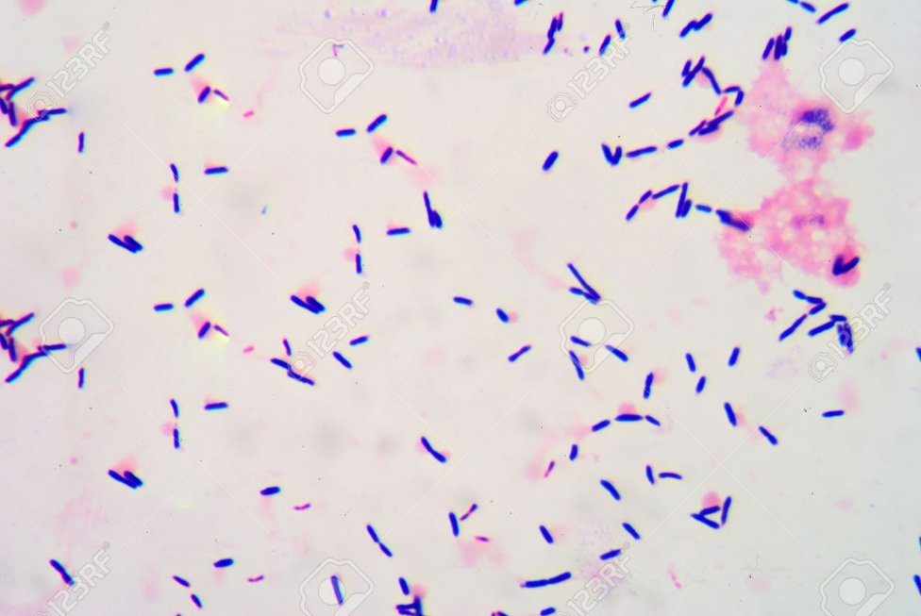
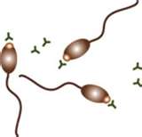
Bacteria
ASA

